Slide 1
An Automatic Approach To Verify Sensor Network Systems
Man Chun Zheng
School of Computing
National University of Singapore

Slide 2
Outline
Introduction
Background & Motivation
Related Works
Formal verification of TinyOS/nesC apps
Methodology
A Lightweight framework for verifying SN apps
Experiment & Discussion
Conclusion
Contributions & Limitations
Future work

Slide 3
Outline
Introduction
Background & Motivation
Related Works
Methodology
Experiment & Discussion
Conclusion

Slide 4
Background
Sensor Networks [1]
Limited physical memory (<1 mb)
Constrained power supply
High concurrency
TinyOS [2]
Small size (<400 kb)
Component-based programming model
Implemented by nesC [2]

Slide 5
Background
Correctness & Reliability of SN
A SN system could be …
Autonomous system (e.g. Home automation )
Safety-critical system (e.g. Forest fire detection)
Concurrent system
Undesirable things:
Design errors
Frequent failures
Testing and Simulation (TOSSIM)
Still not sufficient: Unknown bugs
Model checking -- a better solution (gurantee)

Slide 6
Background
Model Checking
Approach
Construct a formal model
Prove by exhaustively exploring the state space
Pros
Detect errors/bugs thoroughly
Increase correctness & reliability
Cons
Construction of formal model manually is Expensive
State space explosion problem is Common

Slide 7
Motivation
TinyOS/nesC
Mainstream sensor operating system
Correctness & Reliability
Formal verification -- Model Checking
Low-cost verification
Automatic generation of formal models
Our work
Lightweight approach for automatically verifying TinyOS/nesC apps

Slide 8
Outline
Introduction
Related Works
Formal verification of TinyOS/nesC apps
Methodology
Experiment & Discussion
Conclusion

Slide 9
Related works: Verifying TinyOS apps
Formal Method | Approach | Automation | Model Checker
LOTOS [4] | -Formalizing nesC apps -Interaction of components | Manual | NA
CSP [5] | -Interactions between components -TinyOS scheduling & preemption | Manual | FDR
ProMela [8] | -Extracts model from protocol impl. -Generate intrusion model | Automatic (SLEDE [6, 7]) | SPIN
BIP [9] | -Node model extracted from nesC -Nodes connected by BIP connectors | Automatic | HyTech/IF

Slide 10
Related works: Verifying TinyOS apps
Formal Method | Approach | Automation | Model Checker
LOTOS [4] | -Formalizing nesC apps -Interaction of components | Manual | NA
CSP [5] | -Interactions between components -TinyOS scheduling & preemption | Manual | FDR
ProMela [8] | -Extracts model from protocol impl. -Generate intrusion model | Automatic (SLEDE [6, 7]) | SPIN
BIP [9] | -Node model extracted from nesC -Nodes connected by BIP connectors | Automatic | HyTech/IF

Slide 11
Related works: Verifying TinyOS apps
Formal Method | Approach | Automation | Model Checker
LOTOS [4] | -Formalizing nesC apps -Interaction of components | Manual | NA
CSP [5] | -Interactions between components -TinyOS scheduling & preemption | Manual | FDR
ProMela [8] | -Extracts model from protocol impl. -Generate intrusion model | Automatic (SLEDE [6, 7]) | SPIN
BIP [9] | -Node model extracted from nesC -Nodes connected by BIP connectors | Automatic | HyTech/IF

Slide 12
Related works: Verifying TinyOS apps
Formal Method | Approach | Automation | Model Checker
LOTOS [4] | -Formalizing nesC apps -Interaction of components | Manual | NA
CSP [5] | -Interactions between components -TinyOS scheduling & preemption | Manual | FDR
ProMela [8] | -Extracts model from protocol impl. -Generate intrusion model | Automatic (SLEDE [6, 7]) | SPIN
BIP [9] | -Node model extracted from nesC -Nodes connected by BIP connectors | Automatic | HyTech/IF

Slide 13
Related works: Verifying TinyOS apps
Formal Method | Approach | Automation | Model Checker
LOTOS [4] | -Formalizing nesC apps -Interaction of components | Manual | NA
CSP [5] | -Interactions between components -TinyOS scheduling & preemption | Manual | FDR
ProMela [8] | -Extracts model from protocol impl. -Generate intrusion model | Automatic (SLEDE [6, 7]) | SPIN
BIP [9] | -Node model extracted from nesC -Nodes connected by BIP connectors | Automatic | HyTech/IF

Slide 14
Related works: Verifying TinyOS apps
Summary
Most require manual construction of models
Most not consider timed aspects
None implements a domain-specific verifier
None has formal definitions for TinyOS/nesC

Slide 15
Outline
Introduction
Related Works
Methodology
A Lightweight framework for verifying SN apps
Formally defining TinyOS/nesC
nesC to RTS translation rules
Verification of nesC Apps
Experiment & Discussion
Conclusion

Slide 16
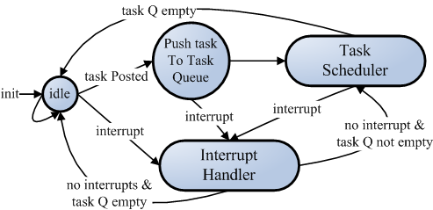
Execution Model of TinyOS
Two levels of scheduler: task & interrupt handler
Task: deferred computation
Interrupt handler: event

Slide 17
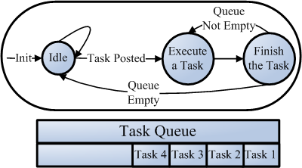
Execution Model of TinyOS
Task Scheduler
Task: deferred computation, run to completion,
no preemption between each other.

Slide 18
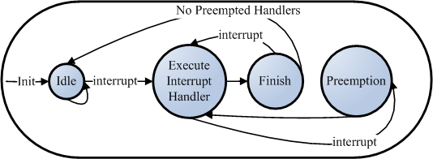
Execution Model of TinyOS
Interrupt handler Scheduler
Interrupt Handler: later ones preempt previous ones,
preempt tasks, run-to-completion.

Slide 19
nesC & RTS
nesC[2] concepts: interface & component
Interface: declares commands & events
Component
Module: provides/uses interfaces,
implements commands/events.
Configuration: provides/uses interfaces,
wires components to one another.
RTS[3]: a version of CSP with real-time extensions
Global variables, channels, complex data structure …
Process algebra: event prefix, parallel, interleave ...
Timed operations: Wait, timeout, interrupt, …
Supported by PAT[3]: simulation & verification.

Slide 20
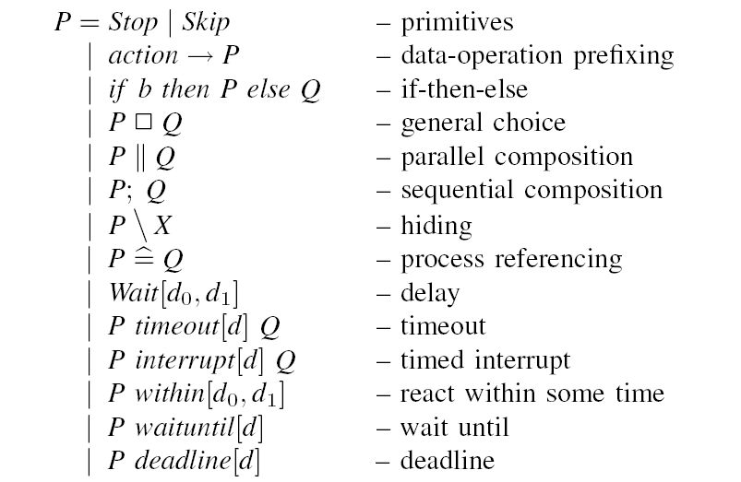
RTS Syntax

Slide 21
nesC to RTS
Between nesC & RTS
nesC app | RTS characteristics
Concurrent | Successful for concurrent systems
Event-driven | Event-based formalism
Hierarchy of components | Hierarchy of processes
Wiring components with bi-directional interfaces | Processes communicate via channels, common events, shared variables, etc

Slide 22
nesC to RTS rules
Translation Rule 1:
interface → constants identifying commands/events
interface intf | RTS constant
command cmd1 command cmd2 ... event evt1 event evt2 ... | #define intf_cmd1 1; #define intf_cmd2 2; ... #define intf_evt1 1; #define intf_evt2 2; ...

Slide 23
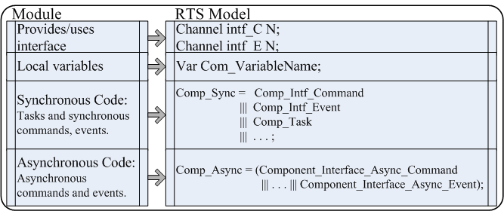
nesC to RTS rules
Translation Rule 2a:
module: interface, command/event implementation,
task, local variables, etc.

Slide 24
nesC to RTS rules
Translation Rule 2b:
command, event, task implementations.
nesC impl. | RTS structure
(comp) intf.cmd | comp_intf_cmd = comp_intf_C?id_{cmd} → CMD → comp_intf_cmd;
(comp) intf.evnt | comp_intf_evnt = comp_intf_E?id_{evnt} → EVNT → comp_intf_evnt;
(comp) tsk | tsk = sdl?tsk_{id} → RunTask → sdl !EOT → Tsk;

Slide 25
nesC to RTS rules
Translation Rule 3:
configuration: wiring components, → ← =.
Wiring | RTS process
user.intf1 → prov.intf2 or prov.intf2 ← user.intf1 | Wire = CommandCall ||| EventSignal; CommandCall = user_intf1_C?x → prov_intf2_C!x → CommandCall; EventSignal = prov_intf2_E?x → user_intf1_E!x → EventSignal;
conf.intf1 = comp.intf2 | Wire = CommandCall ||| EventSignal; CommandCall = conf_intf1_C?x → comp_intf2_C!x → CommandCall; EventSignal = conf_intf1_E?x -> comp_intf2_E!x → EventSignal;

Slide 26
nesC to RTS rules
Translation Rule 4: nesC statements
Type | Statement | RTS Structure
assignment | a = E; | event{a = E;}
atomic block | atomic{ S1; S2; … } | atomic{ e1{S1} -> e2{S2} -> … }
command call | call intf.cmd(…); | comp_intf_C!constant(cmd);
event signal | signal intf.evnt(…); | comp_intf_E!constant(evnt);
task post | post tsk(); | add task id_{tsk} to Q_{t} (task queue);
if-else | if (B) A else C | IF = if (B) A else C;
while | while (B) A | WHILE = if(B) A;WHILE else Skip;
do-while | do A while (B) | WHILE = A; if(B) WHILE else Skip;
for | for (A; B; C) D | FOR = A; ReFor; ReFor = if(B) D; C; ReFor else Skip;

Slide 27
nesC to RTS rules
Translation Rule 5: task scheduler

Slide 28
nesC to RTS rules
Translation Rule 5: task scheduler
#define EOT -1;
channel sdl 0;
var <Queue> Q_{t};
var id_{tsk};
TaskSdl = if (Q_{t}.Count()! = 0) {
getTask{id_{tsk} = Q_{t}.First()} → sdl!id_{tsk}
→ sdl?EOT → deTask{Q_{t}.Dequeue()} → TaskSdl
}

Slide 29
nesC to RTS rules
Translation Rule 5: task scheduler
Finally, the whole app:
#define EOT -1;
channel sdl 0;
var <Queue> Q_{t};
var id_{tsk};
TaskSdl = if (Q_{t}.Count()! = 0) {
getTask{id_{tsk} = Q_{t}.First()} → sdl!id_{tsk}
→ sdl?EOT → deTask{Q_{t}.Dequeue()} → TaskSdl
}
System = TaskSdl |||Comp_Sync ||| … Comp_Sync
||| Comp_Async ||| … ||| Comp_Async;

Slide 30
Verification
Types of Properties in PAT [16,17,18]
Type | Assertion | Property
Deadlockfree | #assert System deadlockfree | The system is deadlock free.
Divergence Freeness | #assert System divergencefree | The system is divergence free.
 | #assert System divergencefree<T> | The system is timed divergence free.
Reachability | #assert System reaches ledon_{s} | The system reaches the state ledon_{s}.
Temporal Properties | #assert System |= [](BlinkC.Timer0.fired | Timer0 is fired infinitely often.
 | #assert System |= [](BlinkC.Timer0.fired → (<> LedsC.Leds.led0Toggole)) | led0 should eventually be toggled whenever Timer0 is fired.
Refinement | #assert System refines P1 | The traces of the system is a subset of those of P1.
 | #assert System refines<T> P2 | The timed traces of the system is a subset of those of P2.

Slide 31
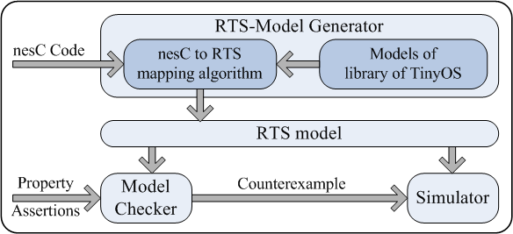
Overview of the framework

Slide 32
Outline
Introduction
Related Works
Methodology
Experiment & Discussion
Conclusion

Slide 33
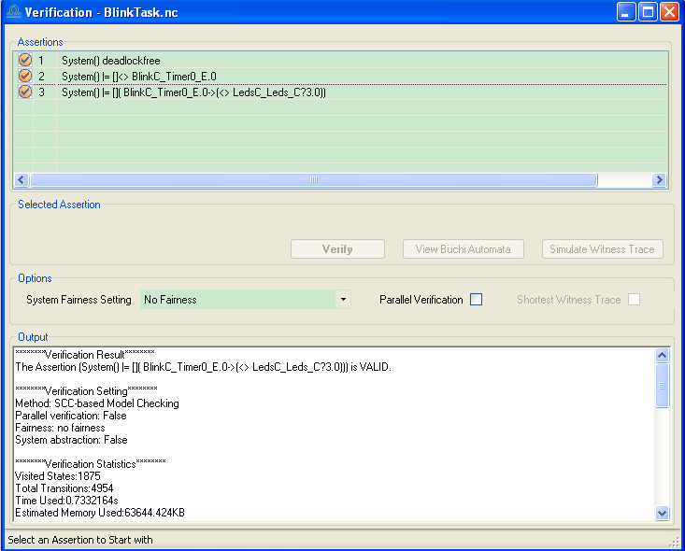
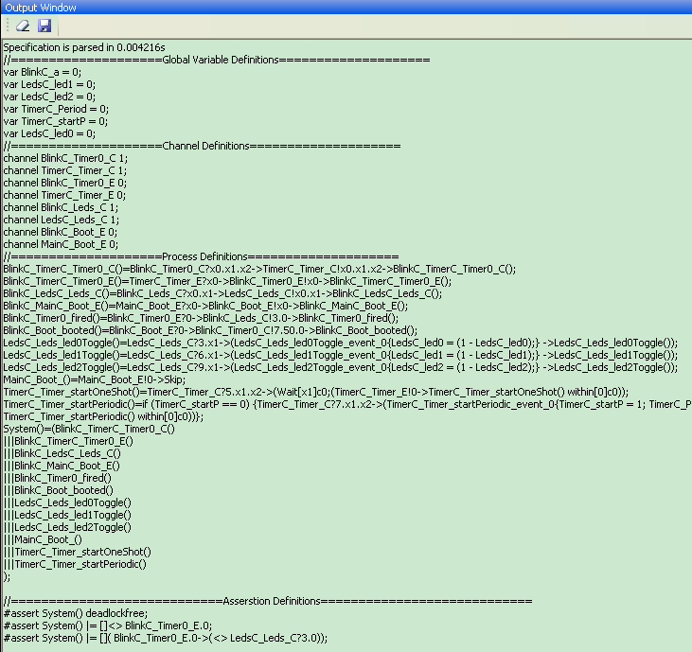
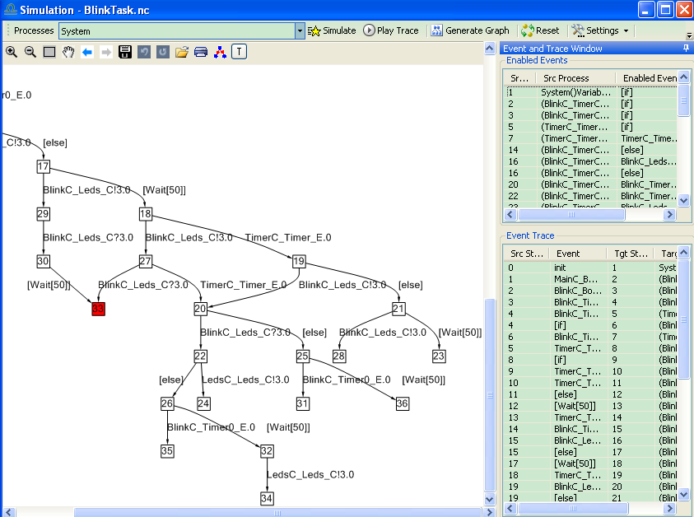
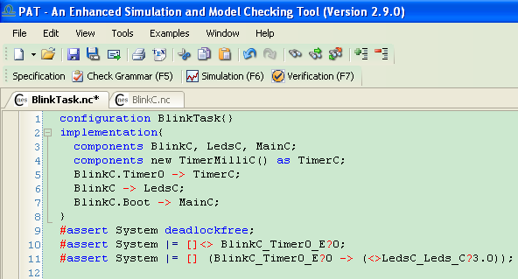
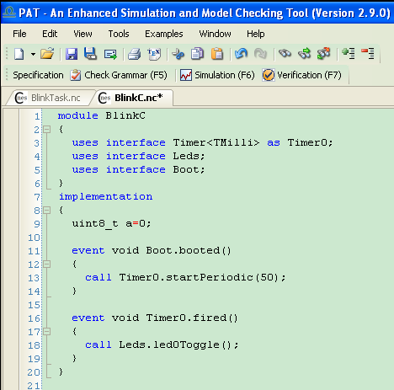
Example: BlinkTask app

Slide 34
Experiment results
System | Assertion | Result | States | Time(s)
BlinkTask (1 timer, 1 led) | P1 | True | 397 | 0.18
 | P2 | True | 1,926 | 0.50
 | P3 | True | 1,875 | 0.55
BlinkTask’ (3 timers, 3 leds) | P1’ | True | 158,668 | 78.27
 | P2’ | True | 1,397,580 | 1,420.72
 | P3’ | True | 1,238,588 | 1,039.30
P1: #assert System deadlockfree;
P2: []<> BlinkC.Timer.fired;
P3: [] (BlinkC.Timer.fired → (<> LedsC.Leds.led0Toggle));

Slide 35
Discussion: is the approach sound?
Lack of formal description of nesC or TinyOS
Ongoing solution:
Define operational semantics of nesC (Sec. 3-A)
Define RTS semantics of TinyOS/nesC (Sec. 3-A)
Prove the bi-simulation between the above

Slide 36
Outline
Introduction
Related Works
Methodology
Experiment & Discussion
Conclusion
Contributions & Limitations
Future work

Slide 37
Contributions & Limitations
Contributions
Verifying TinyOS apps for many properties
Automatically extracted RTS models from nesC code
Model generation & verification in one framework
Formal definitions of TinyOS/nesC
Limitations
Some syntax of nesC not supported
Weak scalability
Only model individual nodes

Slide 38
Future Work
Completeness: develop full nesC-syntax supports
Multiple wiring, struct, pointer, etc.
Optimization: fix state space explosion problem
Make translation rules abstract –- smaller
Develop more efficient verification techniques -- faster
Further -- Direct verification
Translation-based: usually tedious, need to prove
Need to define operational semantics of nesC
Model the whole network
Interaction between nodes and environments
Probabilistic model checking (e.g. msg loss)

Slide 39
Reference
[1] J. Hill, R. Szewczyk, A.W. an S. Hollar, D. Culler, and K. Pister, “System architecture directions for networked sensors,” in PLOS’00, 2000, pp. 93–104.
[2] D. Gay, P. Levis, R. v. Behren, M. Welsh, E. Brewer, and D. Culler, “The nesC language: a holistic approach to networked embedded systems,” in PLDI’03, 2003, pp. 1–11.
[3] J. Sun, Y. Liu, J. S. Dong, and H. H. Wang, “Verifying stateful timed CSP using implicit clocks and zone abstraction,” in ICFEM’09, 2009.
[4] N. S. Rosa and P. R. F. Cunha, “Behavioural specification of wireless sensor network applications,” in GIIS’07, 2007, pp. 66–72.
[5] A. I. McInnes, “Using CSP to model and analyze TinyOS applications,” in IEEE ECBS’09, 2009, pp. 79–88.
[6] Y. Hanna and H. Rajan, “Slede: framework for automatic verification of sensor network security protocol implementations,” in ICSE Companion’09, 2009, pp. 427–428.
[7] Y. Hanna, H. Rajan, and W. Zhang, “Slede: a domain-specific verification framework for sensor network security protocol implementations,” in WISEC’08, 2008, pp. 109–118.
[8] G. J. Holzmann, “Software model checking with SPIN,” Advances in Computers, pp. 78–109, 2005.

Slide 40
Reference
[9] A. Basu, L. Mounier, M. Poulhi`es, J. Pulou, and J. Sifakis, “Using BIP for modeling and verification of networked systems – a Case study on TinyOS-based networks,” in NCA’07, 2007, pp. 257–260.
[10] J. Sun, Y. Liu, J. S. Dong, and J. Pang, “PAT: towards flexible verification under fairness,” in CAV, 2009, pp. 709–714.
[11] J. Sun, Y. Liu, J. S. Dong, and H. H. Wang, “Specifying and verifying event-based fairness enhanced systems,” in ICFEM, 2008, pp. 5–24.
[12] B. P. Mahony and J. S. Dong, “Timed communicating Object Z,” IEEE Trans. Software Eng., vol. 26, no. 2, pp. 150–177, 2000.
[13] ——, “Blending Object-Z and Timed CSP: an introduction to TCOZ,” in ICSE, 1998, pp. 95–104.
[14] “PAT website,” http://www.comp.nus.edu.sg/∼pat/.
[15] J. Sun, Y. Liu, J. S. Dong, and J. Sun, “Bounded model checking of compositional processes,” in TASE’08, 2008, pp. 23–30.
[16] Y. Liu, W. Chen, Y. A. Liu, and J. Sun, “Model checking linearizability via refinement,” in FM’09, 2009, pp. 321–337.

Slide 41
The End
Thank You!

